Slide 1
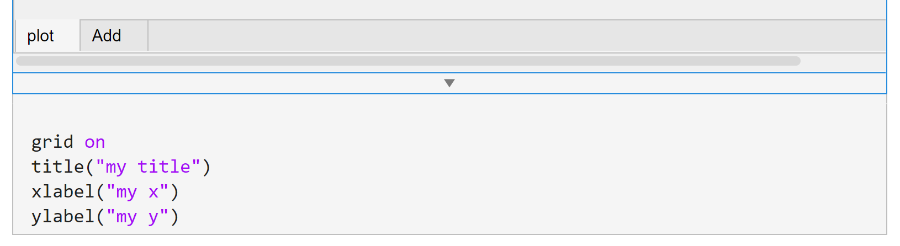
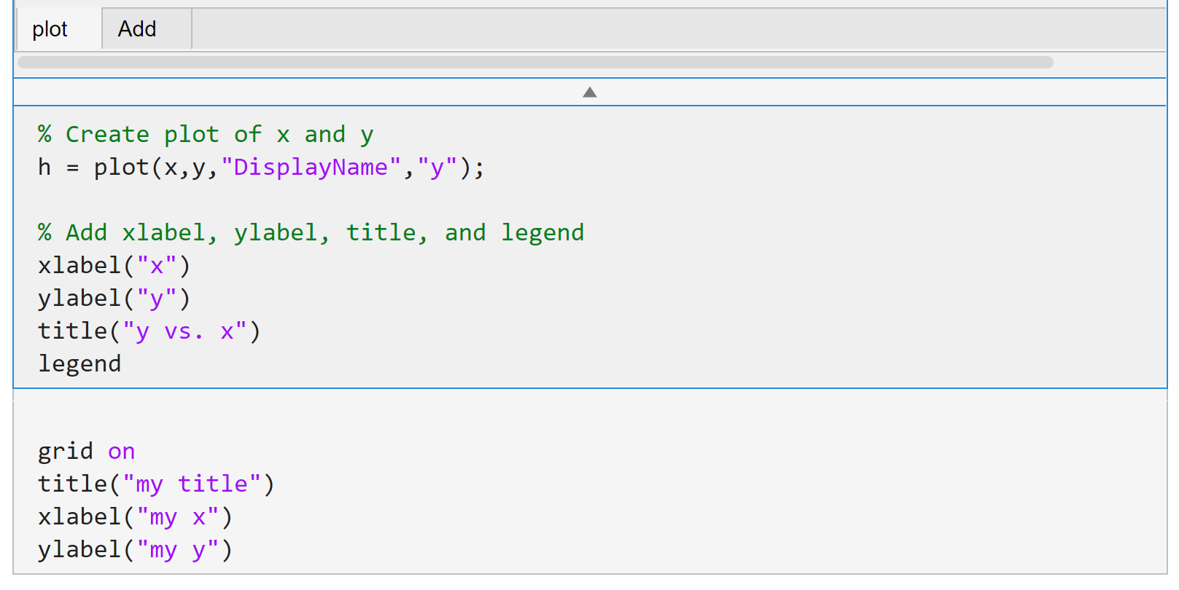
Click

Slide 2
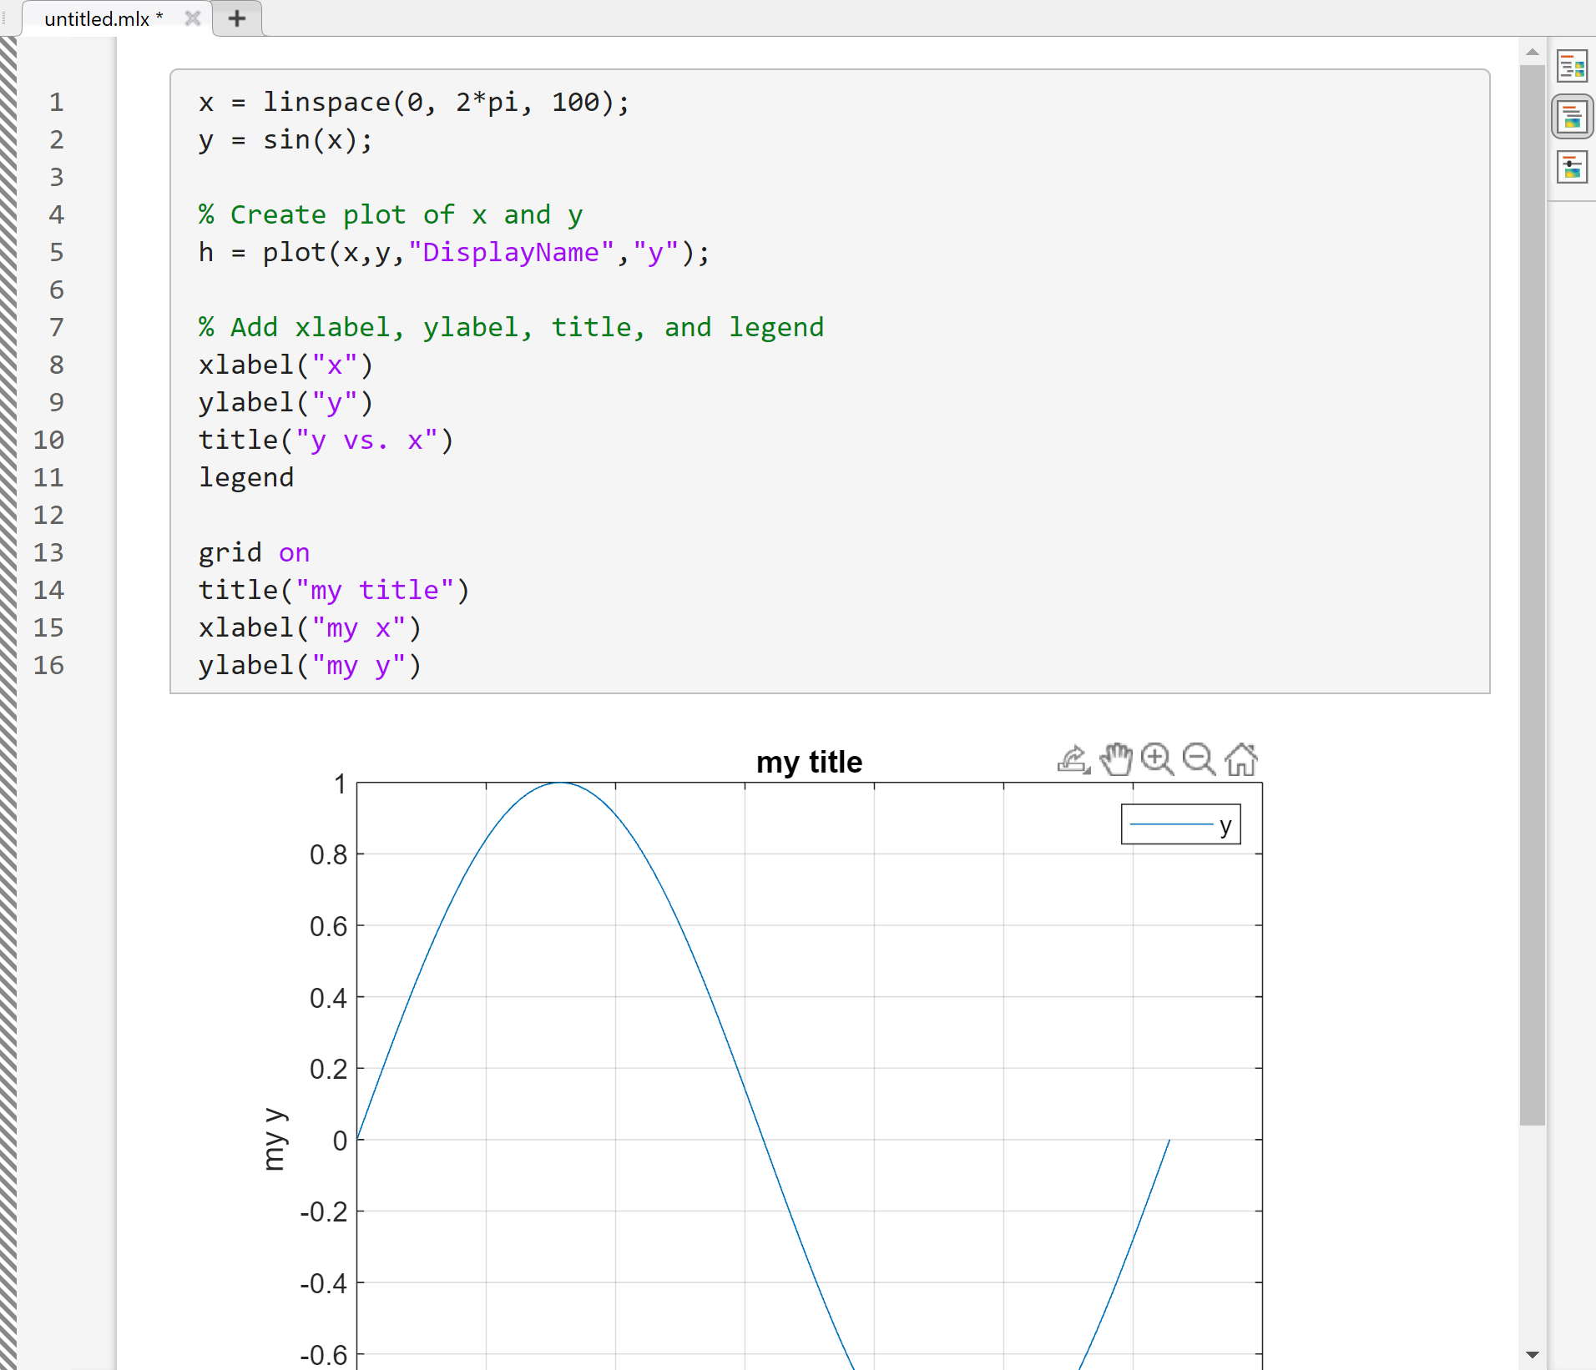
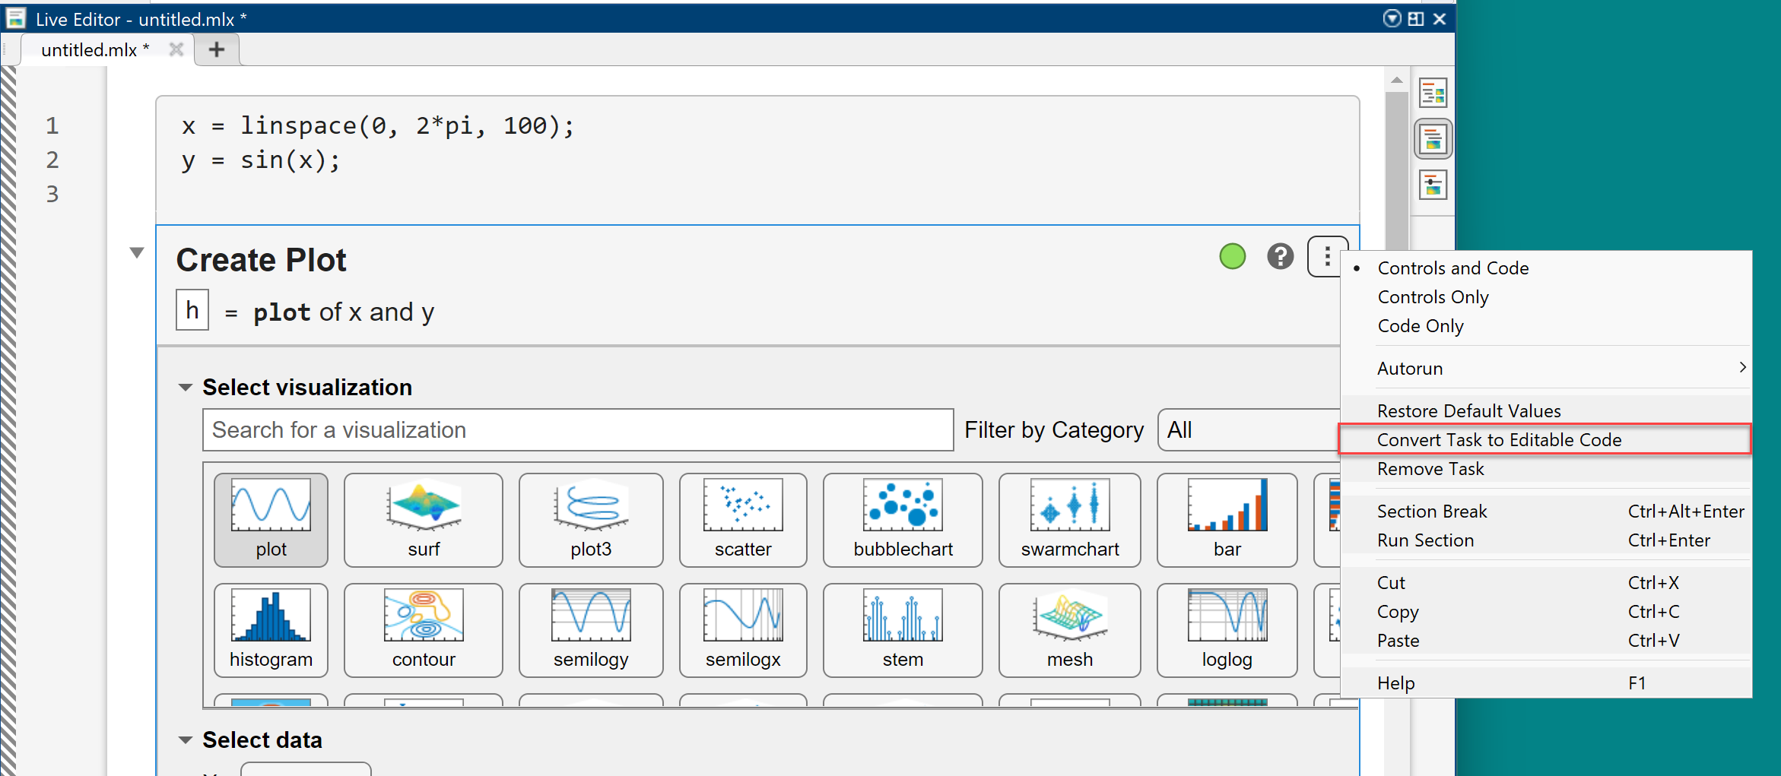

Slide 3



plot([1, 4, 2, 3])
$$y$$
4
3
2
1
$$0$$
1st
2nd
3rd
4th
...
$$x$$

Slide 4

x
y
plot([11, 12, 13, 14], [1, 4, 2, 3])
$$y$$
4
3
2
1
$$0$$
11
12
13
14
...
$$x$$

Slide 5



$$y$$
(1.0, 2.0)
2
1.5
(0.0, 1.3)
(2.0, 1.3)
1
0.5
(0.4, 0.2)
(1.6, 0.2)
$$0$$
0.5
1
1.5
2
...
$$x$$

Slide 6



$$y$$
(1.0, 2.0)
2
1.5
(0.0, 1.3)
(2.0, 1.3)
1
0.5
(0.4, 0.2)
(1.6, 0.2)
$$0$$
0.5
1
1.5
2
...
$$x$$

Slide 7
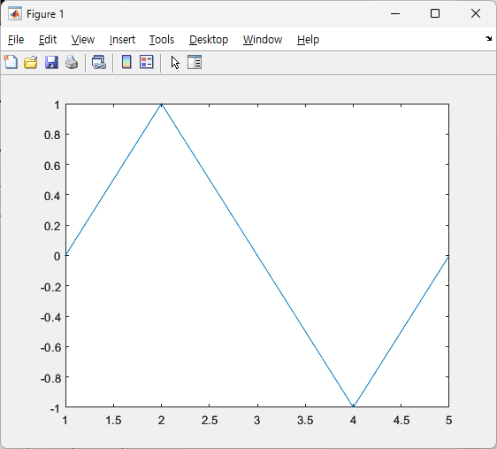







$$x=\left[0,\frac{π}{2}, π,\frac{3π}{2}, 2π\right]$$
y = sin(x)
$$y=[0, 1, 0, −1, 0]$$
plot(y)
$$y\left(2\right)=1$$
$$y\left(1\right)=0$$
$$y\left(3\right)=0$$
$$y(5)=0$$
$$y(4)=0$$

Slide 8
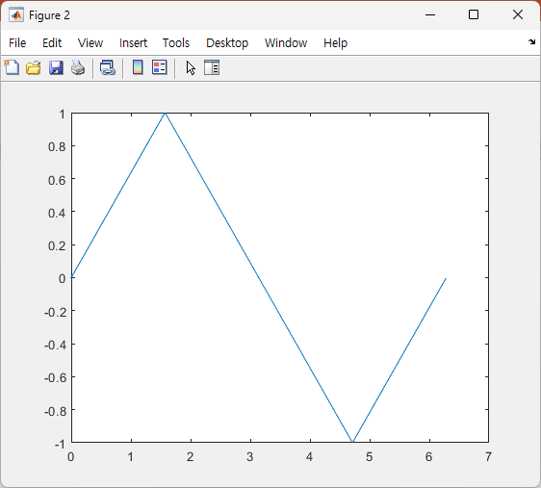










plot(y)
plot(x, y)
$$1$$
$$2$$
$$3$$
$$4$$
$$5$$
$$0$$
$$π/2$$
$$π$$
$$3π/2$$
$$2π$$

Slide 9
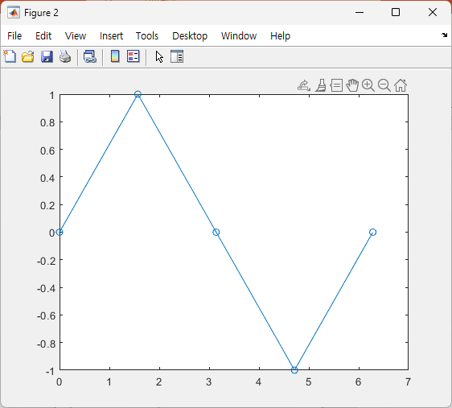










plot(x, y)
plot(x, y, ‘o-’)
$$y\left(2\right)=1$$
$$y\left(2\right)=1$$
$$y(5)=0$$
$$y\left(1\right)=0$$
$$y\left(3\right)=0$$
$$y(5)=0$$
$$y\left(1\right)=0$$
$$y\left(3\right)=0$$
$$y\left(4\right)=−1$$
$$y\left(4\right)=−1$$

Slide 10
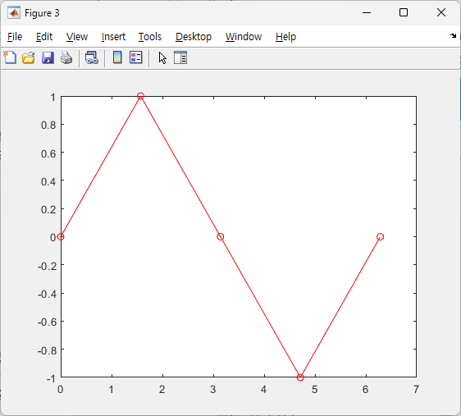
plot(x, y, ‘o-’)
plot(x, y, ‘ro-’)

Slide 11
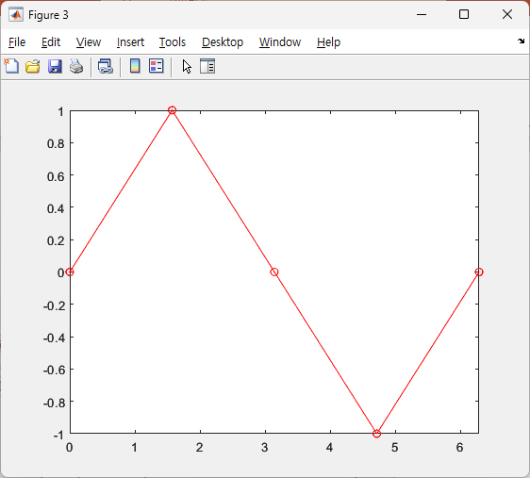
plot(x, y, ‘ro-’);
xlim([0, 2*pi]);
plot(x, y, ‘ro-’)

Slide 12
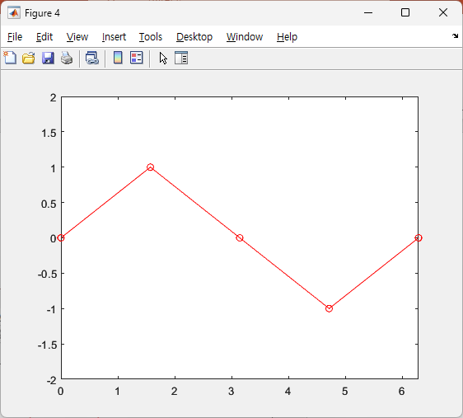
xlim([0, 2*pi]);
ylim([-2, 2]);
xlim([0, 2*pi]);

Slide 13

xticks
xticklabels

Slide 14
(2, 1, 1)
(2, 2, 1)
(2, 2, 2)
(1, 2, 1)
(1, 2, 2)
(2, 1, 2)
(2, 2, 3)
(2, 2, 4)
subplot(#row, #col, index)

Slide 15
(2, 2, 1)
(2, 2, 2)
(2, 2, [3, 4])

Slide 17
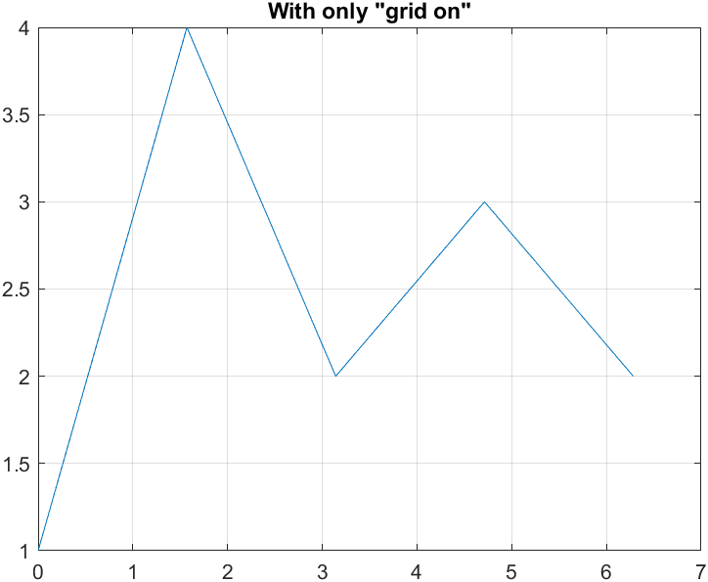
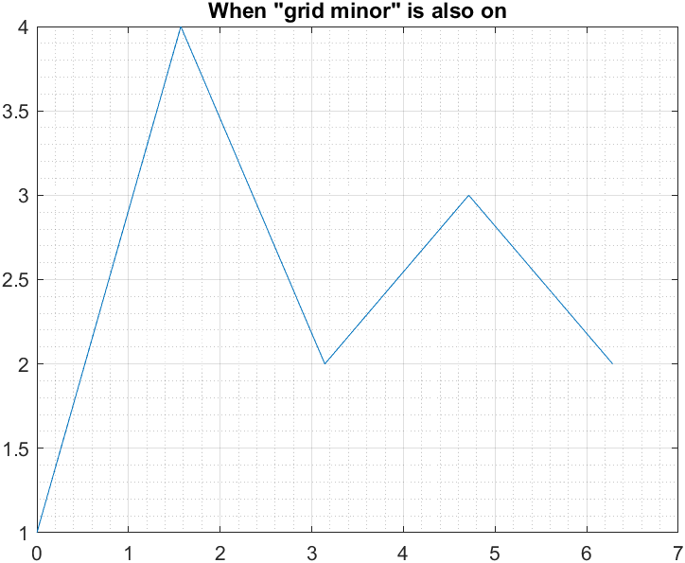

Slide 18
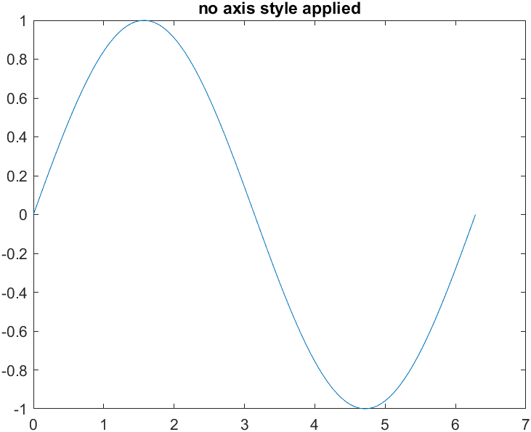
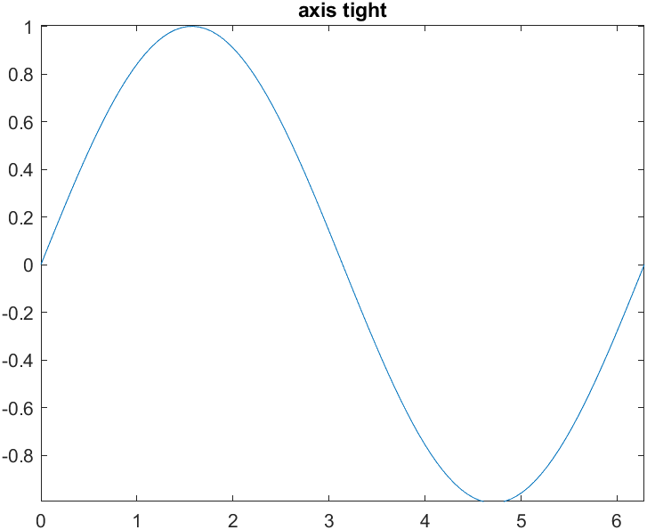

Slide 19
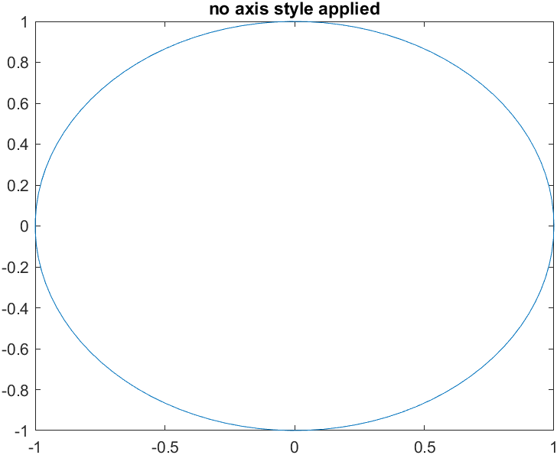
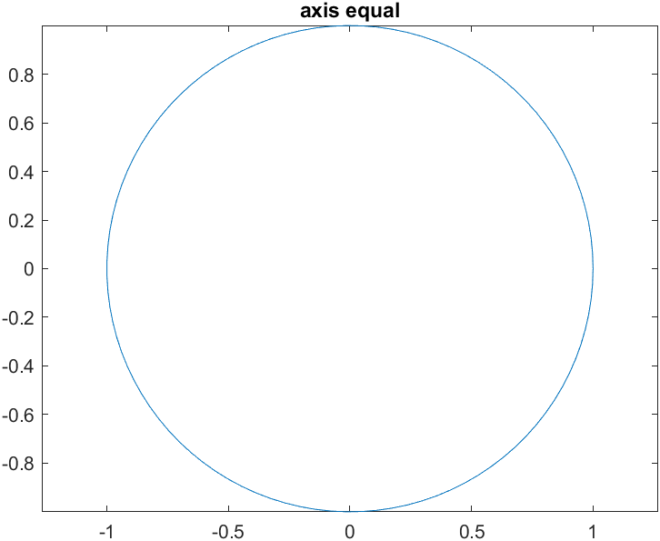

Slide 20
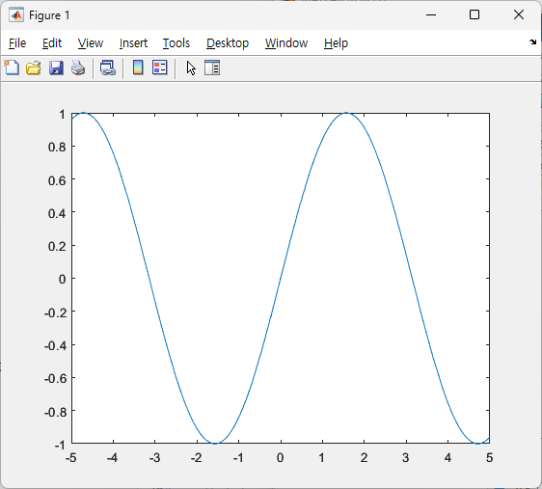
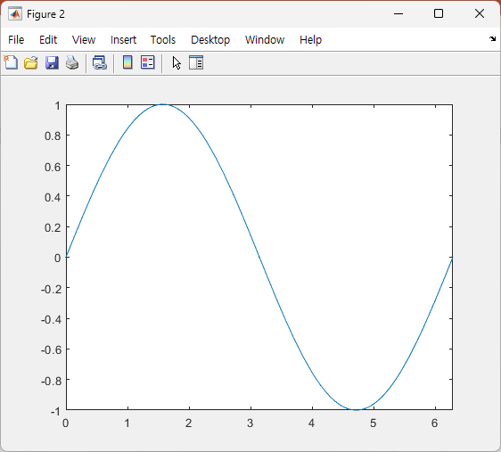
fplot(@(x) sin(x))
fplot(@(x) sin(x), [0, 2*pi])

Slide 23
